Slide 1
Leveraging Service Meshes as a New Network Layer
Sachin Ashok, P. Brighten Godfrey, Radhika Mittal
University of Illinois at Urbana-Champaign

Slide 2
A recent shift from
monolithic to microservice architecture
Network calls
Function calls
API
Gateway
Monolithic
Microservice

Slide 3
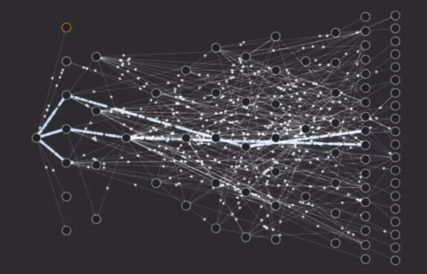
Visualization of a large scale microservice
Usually is a multi-hop DAG with many stages
Developers end up writing a lot of “communication code”…
Netflix Microservice Topology
GIF source: Josh Evans, Netflix
https://www.youtube.com/watch?v=CZ3wIuvmHeM

Slide 4
Service Meshes have emerged to “factor out communication” in microservices
API
Gateway
Internet
Cluster

Slide 5
Service Meshes have emerged to “factor out communication” in microservices
API
Gateway
Internet
Cluster
Sidecar

Slide 6
Service Meshes have emerged to “factor out communication” in microservices
Takes over communication between services at the granularity of an application-level request (e.g., HTTP)
End to end path involves three transport connections
Microservice A → Sidecar A (source)
Sidecar A → Sidecar B
Sidecar B → Microservice B (destination)
microservice
processes it
Sidecar passes request to microservice
1
External HTTP request reaches sidecar
3
Multiple internal requests spawned
2
Internal request is received and sent to microservice

Slide 7
Service Meshes have emerged to “factor out communication” in microservices
Takes over communication between services at the granularity of an application-level request (e.g., HTTP)
End to end path involves three transport connections
Microservice A → Sidecar A (source)
Sidecar A → Sidecar B
Sidecar B → Microservice B (destination)
Data plane (i.e., sidecar) offers:
Load balancing
Name resolution
Encryption
Tracing
Authorization
…
to: ad.services.prod
to: 240.2.3.4

Slide 8
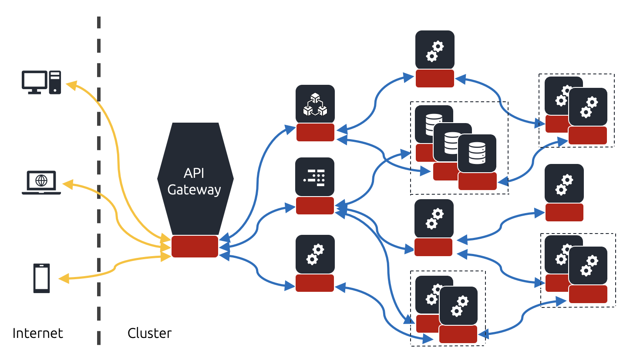
Service Meshes have emerged to “factor out communication” in microservices
Control plane offers global view and policy
Data plane executes local functions
Control Plane
Service Discovery
Certificate Management
Configuration Management

Slide 9
Service Meshes as a New Network Layer
OSI 7 layer
Application
How is it a layer?
Service Mesh
Service mesh abstracts lower layer functionality for the application
E.g., app is unaware of which exact replica of a service it is talking to
Transport
All inbound/outbound app traffic goes through service mesh via the sidecars
Virtualization
Why is that a useful abstraction?
Network
Highlights service meshes as a convenient location to observe and enhance cross-layer communication
Link
Service meshes can be application-agnostic and expose standard APIs which make any optimizations available to all apps running on top of it.
Physical
‘Cloud Native’ Network Stack

Slide 10
New opportunities enabled by Service Meshes
Enhanced visibility
Better knowledge of application needs
Easier evolvability
Coordination with lower layers

Slide 11
Enhanced Visibility
Visibility
Internal app-level
API call tree
HTTP request
Visibility
Network layer (IP) packet
Enhanced visibility is useful for
Monitoring
Troubleshooting
Root cause analysis
Sidecar

Slide 12
New opportunities enabled by Service Meshes
Enhanced visibility
Better knowledge of application needs
Easier evolvability
Coordination with lower layers

Slide 13
Better knowledge of application needs
With Service Mesh APIs, apps can directly signal preferences
flowSize
priority
Dozens of proposals assume knowledge of application specifics
Priority aware flow scheduling
App-aware traffic engineering
…
API
Sidecar
These proposals could be made more practical through service meshes

Slide 14
New opportunities enabled by Service Meshes
Enhanced visibility
Better knowledge of application needs
Easier evolvability
Coordination with lower layers

Slide 15
Easier evolvability
Service meshes provide convenient platform to deploy new functionality.
Run in user space on end-hosts
Service Mesh APIs are easily extensible
e.g., WebAssembly (WASM) extensions can be used to extend the sidecars directly
Sidecar
BBR
Copa
PCC
Custom Transport Protocols

Slide 16
New opportunities enabled by Service Meshes
Enhanced visibility
Better knowledge of application needs
Easier evolvability
Coordination with lower layers

Slide 17
Coordination with lower layers
SDN controller can provide explicit hints to the sidecar
e.g., via congestion notification
(1) Congestion increases!
Sidecar
(2) SDN controller notifies service mesh
(3) Service mesh reroutes traffic
High
congestion!
SDN
controller

Slide 18
Case study (leveraging several opportunities mentioned before)
Reviews 1
Latency
sensitive
API
Gateway
Front End
Reviews 2
- Users traversing a website
- Media streaming
Details
Ratings
Non latency
sensitive
E-library microservice
- Batch analytics jobs
- Log processing
Goal — To provide request-level prioritization for latency-sensitive requests in this microservice application which serves a mix of workloads

Slide 19
Design components
Is this request
latency-sensitive?
or
Reviews 1
Latency
sensitive
API
Gateway
Front End
Reviews 2
High priority tag
Low priority tag
Details
Ratings
Non latency
sensitive
Classify applications’ performance objectives at the ingress
The front-end application tags requests as either high or low priority
Uses custom HTTP header fields to pass this priority information to the sidecar

Slide 20
Design components
Reviews 1
Latency
sensitive
API
Gateway
Front End
Reviews 2
High priority tag
Low priority tag
Details
Ratings
Non latency
sensitive
Carry these performance objectives (i.e., priorities) through the entire system
Every sidecar copies priority bits of incoming requests onto any outgoing requests it spawns

Slide 21
Design components
Reviews 1
Latency
sensitive
API
Gateway
Front End
Reviews 2
Details
Ratings
Non latency
sensitive
Implement cross-layer prioritization at the sidecars
Prioritization at the request/message queue level (e.g., at the RabbitMQ queue)
Choice of transport protocol (BBR, LEDBAT, PCC Proteus) as per QoS of the request
Kernel prioritization for latency sensitive packets

Slide 22
Evaluation Setup
Workload Generators
Reviews 1
Latency
sensitive
API
Gateway
Front End
Reviews 2
Details
Ratings
Non latency
sensitive
More details in the paper …
Network bottleneck (1 Gbps)

Slide 23
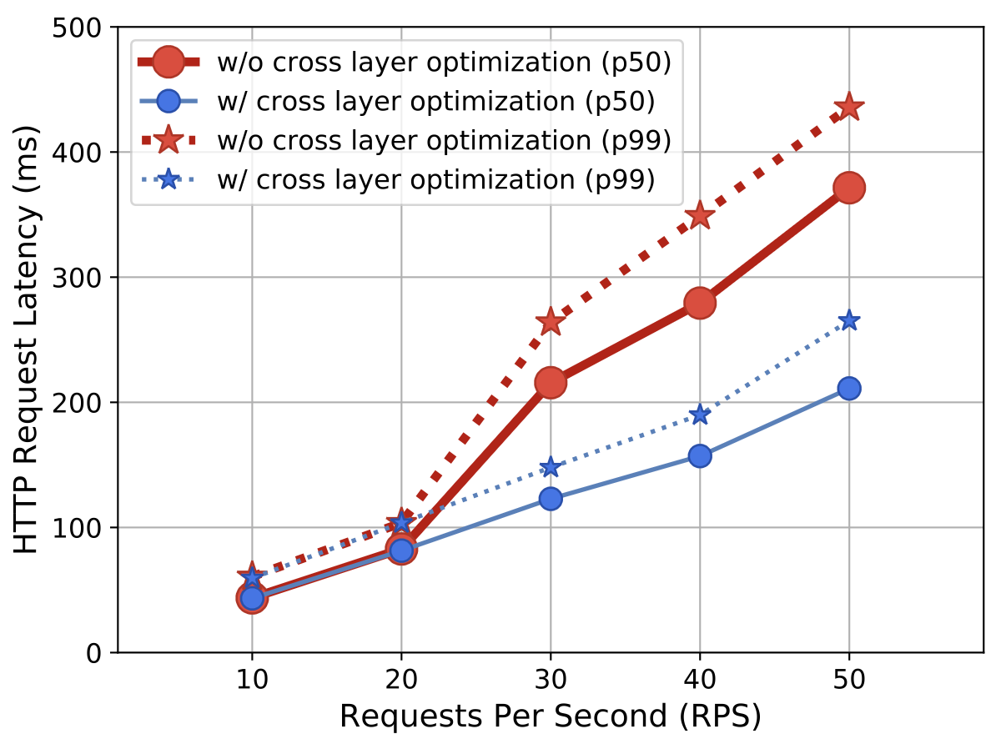
Preliminary Results
What does this prototype demonstrate?
Use knowledge of app needs across the microservice via provenance tracing (in this case, we trace priority of requests through the microservice)
Easily evolvable sidecar can deploy many optimization schemes without modifying the app
Abstract the details from the app and make these optimizations available to any app running on top of the service mesh layer (i.e., no tight coupling)
Cross layer optimization reduces latency for high priority traffic

Slide 24
Challenges and Future Directions
Added latency due to sidecars
Explore kernel-bypass techniques to improve performance
Dagger: Efficient and Fast RPCs in Cloud Microservices with Near-Memory Reconfigurable NICs
Nikita Lazarev, Shaojie Xiang, Neil Adit, Zhiru Zhang, Christina Delimitrou
ASPLOS 2021
Different layers may conflict in terms of their roles and functionality
For example, app layer LB might conflict with network layer LB
How do we define the scope of responsibilities?
Towards Verified Self-Driving Infrastructure
Bingzhe Liu, Ali Kheradmand, Matthew Caesar, P. Brighten Godfrey
HotNets 2020
Extending cross-layer prioritization
Include compute and storage level prioritization

Slide 25
Summary
Service meshes are a new emerging layer in the cloud networking stack
Many new research opportunities leveraging
Enhanced visibility
Knowledge of application needs
Evolvability
Cross-layer coordination
Our prototype leverages several of these opportunities to achieve fine-grained cross-layer prioritization of requests without tight coupling with the application

